Slide 1
Macroeconomics
マクロ経済学
Chap.13. Investment and Capital
第13章 投資と資本

Slide 2
Investment = Important economic activity which accounts for about 20% of national income, its fluctuation is larger than private consumption, strong influence on economic fluctuation and economic growth.
Capital = firms’ tools, machinery equipment, and factory,
Input of production factors such as labor, raw materials, capital ⇒ production activity
Investment , capital formation = economic activity to increase capital
⇒ Round-about production which use capital with embodying advanced technology
⇒ Dramatic improvement in production capacity and productivity
Investment (= capital formation) is an economic concept of flow
Capital = stock concept including tools, machinery equipment and factories accumulated as a result of yearly investment activities
投資＝国民所得の約2割を占める重要な経済活動、民間消費に比べて変動が大、景気変動や経済成長に強い影響。
資本（capital）＝企業の道具や機械設備、工場、
労働と原材料、資本など生産要素の投入⇒生産活動
投資（investment）、資本形成（capital formation）＝資本を増やす経済活動
⇒高度の技術を体化した資本を用いる迂回生産⇒生産能力や生産性の飛躍的向上
投資（＝資本形成）はフローの経済概念
資本＝年々の投資活動の結果として蓄積された道具や機械設備のストック概念

Slide 3
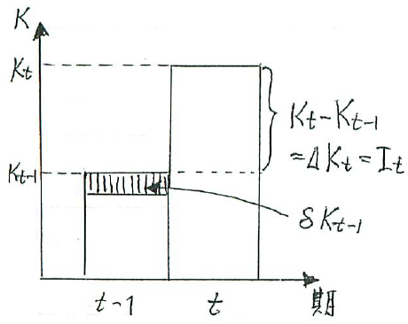
１．Investment and Capital 投資と資本
Direct production = primitive production method to catch fish with bare hands and to collect plants
Round-about production = Initially direct labor to make means of production such as fishing hooks, fishing nets, fishing boats, plows, cultivators, etc. Then use them to obtain products
Human beings using tools (capital), the history of round-about production is exactly the history of mankind.
Capital = means of production such as tools, equipment and machinery to be input for round-about production
Capital stock = the amount of capital existing at a certain point in time
Investment, Capital formation, capital accumulation = economic activity to increase capital stock = flow during one period
The capital stock at the end of the term is expressed as K_{t},
The capital stock at the end of the t－1 period before one term is K_{t－1}、⇒ The difference ΔK_{t} is investment in period t. I_{t}＝K_{t}－K_{t－1}＝ΔK_{t}
直接生産（direct production）＝素手で魚を捕らえ植物を採集する原始的生産方法
迂回生産（round-about production）＝初めに釣り針や漁網、漁船、鋤、耕運機などの生産手段を作るために労働を振り向け、次にそれらを用いて生産物を獲得
人間は道具（資本）を使う動物、迂回生産の歴史はまさに人類の歴史。
資本（capital）＝迂回生産のために投入される道具、機器、機械など
の生産手段
資本ストック（capital stock）＝ある1時点における資本の存在量
投資（investment）、資本形成（capital formation）、資本蓄積（capital
accumulation）＝資本ストックを増加させる経済活動＝1期間に行われる
フロー（flow）流量. t期末の資本ストックをK_{t}で表し、1期前のt－1期末の
資本ストックをK_{t－1}、⇒その差額ΔK_{t}がt期における投資I_{t}
I_{t}＝K_{t}－K_{t－1}＝ΔK_{t} ⇒13-1図 投資と資本ストック

Slide 4
１B．Investment and Capital 投資と資本
When capital is used in a production process, capital wears away and its value depreciates
⇒ Converted to the value of the product = capital depreciation, depreciation,
⇒ to deposit it as expenses is depreciation expense
(Example) When producing with capital of 10 million yen and amortizing the capital in 10 years
Constant amount method ⇒ depreciate the constant amount of 1 million yen annually and to convert it to the commodity value of product⇒ embed 1 million yen in product price
Constant rate method ⇒ depreciate by a constant rate of depreciation
Depreciation expenses⇒ 1 million yen × 10 years = accumulate a deposit of 10 million yen
⇒ to use it for a renewal of new capital equipment= Replacement investment
When depreciating at fixed rate δ, I_{t}＝K_{t}－K_{t－1}＋δK_{t－1}＝ΔK_{t}＋δK_{t－1}＝K_{t}－(1－δ)K_{t－1}
Investment including depreciation expenses = gross investment
Net investment = the net increase in capital stock (K_{t}－K_{t－1})
Difference between gross domestic product and net domestic product=depreciation
生産過程で資本を使うと資本はすり減って価値が減耗⇒その分だけ生産物の価値に転化＝資本減耗（capital depreciation）、減価償却（depreciation）
⇒それを費用として積み立てる金額を減価償却費（depreciation expense）
（例）1千万円の資本を使って生産を行い、資本を10年で償却する場合
定額法⇒毎年1百万円の資本減耗、商品価値に転化⇒商品価格に1百万円組込み
定率法⇒定率で減耗
減価償却費⇒1百万円×10年＝1千万円積み立て⇒新しい資本設備を更新＝更新投資（replacement investment）, 定率δで減価償却する場合 I_{t}＝K_{t}－K_{t－1}＋δK_{t－1}＝ΔK_{t}＋δK_{t－1}＝K_{t}－(1－δ)K_{t－1}
減価償却費を含めた投資を粗投資（gross investment）
資本ストックの純増分(K_{t}－K_{t－1})を純投資（net investment）
国内総生産と国内純生産の違い＝減価償却費

Slide 5
２． GDP and Fluctuation of Investment GDPと投資の変動
Shares of various expenditures among GDP (2016) in Japan
Private final consumption expenditure is about 56%, gross investment = gross fixed capital formation is about 23%. The private sector's gross investment is about 18% and the public sector's gross investment is about 5%.
Among private investment, equipment investment of machinery and equipment is about 15%, housing investment such as housing is about 3%.
Total fixed capital formation
Tangible fixed capital formation = machinery, equipment, buildings etc.
Intangible fixed capital formation = computer software, etc., the growth rate is remarkable.
Private final consumption(56%) + total fixed capital formation(23%) + government consumption expenditure(20%)
Total fixed capital formation=Private investment (18%) + Government investment (5%)
(Source) "National Accounts Calculation", FY 2016 13-2 figure
日本のGDPに占める割合（2016 年）
民間最終消費支出が約56％、粗投資＝総固定資本形成（gross fixed capital formation）は約23％。民間部門の粗投資は約18％、公的部門の粗投資は約5％。
民間粗投資の内，機械や設備などの設備投資（equipment investment）が約15％、住宅などの住宅投資（housing investment）が約3％。
総固定資本形成
有形固定資本形成＝機械、設備、建物など
無形固定資本形成＝コンピューター・ソフトウェアなど、伸び率が著しい。
民間最終消費56% ＋総固定資本形成23% ＋政府消費支出20%
総固定資本形成＝民間投資18%＋政府投資5%
（資料）『国民経済計算』、2016年度 13-2図

Slide 6
２B.GDP and Fluctuation of Investment GDPと投資の変動
Total fixed capital formation + inventory investment = total capital formation (gross capital formation), inventory investment ratio is about 0.3%
Figure 13-3, historical change rates from 1995 to 2010 in nominal GDP, private consumption, private-sector capital investment
Standard deviation is 2.2 for GDP, 1.3 for private consumption 1.3, 6.8 for private capital investment.
⇒ Private consumption is the most stable, GDP is doubled, private capital investment is five times that
⇒ While private sector capital investment leads the economic fluctuation as a major fluctuation factor against the economic fluctuation indicated by the upward and downward movements of the GDP growth rate, private consumption is rather a stabilizing factor
In 2009, due to the worldwide recession after the collapse of Lehman Brothers, nominal GDP was the worst negative growth rate of 6.4% after World War, the decline in private capital investment, which was the worst negative growth of 19.7% after the war is very significant. Private consumption is a growth of minus 3.2%, rather it is a stabilizing factor.
総固定資本形成＋在庫投資＝総資本形成、在庫投資の
割合は0.3％程度
13-3図、名目のGDP、民間消費、民間設備投資の1995
～2010年の変化率
標準偏差はGDPが2.2、民間消費が1.3、民間設備投資が6.8
⇒民間消費が一番安定的、GDPがその倍、民間設備投資は
その5倍⇒GDP成長率の上下運動で示される景気変動に対し、
民間設備投資が非常に大きな変動要因として景気変動を牽引
する一方、民間消費はむしろその安定化要因
リーマン・ショック後の世界同時不況で2009年、名目GDPは
戦後最悪のマイナス6.4％の成長率、戦後最悪のマイナス19.7
％の成長であった民間設備投資の落ち込みが非常に大きく影
響。民間消費はマイナス3.2％の成長で、むしろ安定化の作用。

Slide 7
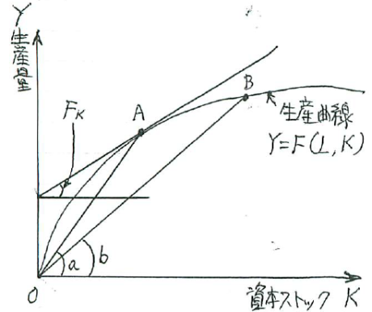
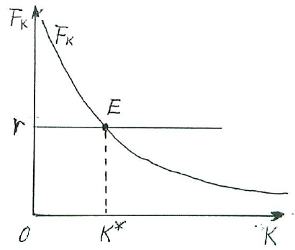
３．Determination of Optimum Level of Capital in 1 Period Model
1期間モデルによる資本の最適水準の決定
Macro production function = a function F to input labor L and capital K as production factors and to produce output Y. Depicted by a production curve in geometry. Y＝F(L, K)
Marginal productivity of capital, marginal rate of return on capital = a ratio of increased product ΔY against increased capital ΔK when labor is maintained constant. ΔY／ΔK
If Δ is brought infinitely close to zero, it is dY／dK.
Leave the labor L constant, differentiate a production function partially with respect to K
Partial derivative ⇒ ∂Y／∂K＝∂F(L, K)／∂K＝F_{K}
Marginal product (or productivity) of capital F_{K} is the tangent slope of the production curve in geometry.
マクロの生産関数（production function）＝生産要素として労働Lと資本Kを投入し、生産物Yを生産する次の関係F. 幾何では生産曲線。 Y＝F(L, K)
資本の限界生産力（marginal productivity of capital）、資本の限界収益率（marginal rate of return on capital）＝労働を一定のまま、資本を1単位ΔK増加すると、生産能力が増えるから生産物も何単位ΔYか増える比率= ΔY／ΔK
Δを微小に近づければ、それはdY／dK
労働Lを一定のまま、生産関数をKに関して
偏微分⇒∂Y／∂K＝∂F(L, K)／∂K＝F_{K}
資本の限界生産力F_{K}は、生産曲線の接線
の傾き。

Slide 8
３B.Determination of Optimum Level of Capital in 1 Period Model
． 1期間モデルによる資本の最適水準の決定
The law of diminishing marginal productivity = The productivity per 1 unit of capital decreases as you increase the amount of capital input, so the slope of the tangent line gradually decreases.
Average productivity Y / K = Slope of a straight line drawn from point A on the production curve to the origin. The slope b of the straight line drawn from the point B to the origin is also an average productivity but is smaller than that. As you increase the amount of capital input, the average productivity diminishes.
Cost of capital or user cost of capital = Cost to put capital into the production process. For example, interest rates on bank loans and corporate bonds.
The optimal stock of capital K * is determined at point E where marginal productivity of capital F_{K} = market rate of interest r.
限界生産力逓減の法則（the law of diminishing marginal productivity）＝資本の投入量を増やしていくと、資本1単位当たりの生産力は減少していくので、接線の傾きは次第に小さくなる。
平均生産力Y／K＝生産曲線上の点A点から原点に引いた直線の傾きa。B点から原点に引いた直線の傾きbも平均生産力、aよりは小。資本の投入量を増やしていくと、平均生産力が逓減。
資本コスト（cost of capital）ないし資本の使用者費用（user cost of capital）＝生産過程に資本を投入するための費用。例えば銀行借入や社債の利子率
資本の最適ストックK*は、資本の限界生産力F_{K}＝市場利子率rとなるE点で決定。

Slide 9
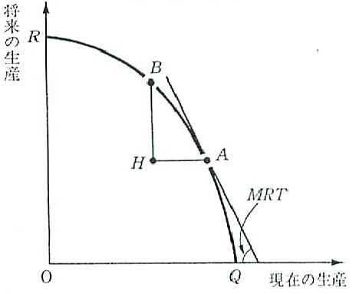
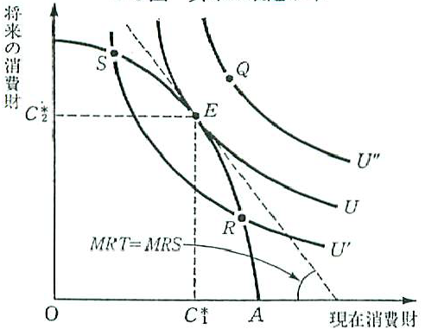
４．Determination of Optimum Level of Capital in 2 Period Model
2期間モデルによる最適投資水準の決定
Production possibility curve = the maximum possible combination of Y₀ and Y₁ when you direct given production factors to the production of current consumer goods Y₀ and future consumer goods Y₁.
When you direct every factors to the production of current consumer goods ⇒ it is depicted by the point Q, and the production of future consumer goods is zero.
Marginal Rate of Transformation = Slope of the line segment AB＝ BH／AH
＝－ΔY₁／ΔY₀→－dY₁／dY₀
生産可能性曲線（production possibility curve）＝所与の生産要素を現在の消費財生産Y₀と将来の消費財生産Y₁に振り向ける場合、Y₀とY₁の最大限可能な組み合わせすべてを現在の消費財生産に振り向ける⇒Q点の現在生産、将来の消費財生産はゼロ
限界変形率＝線分ABの傾き⇒BH／AH＝－ΔY₁／ΔY₀→－dY₁／dY₀

Slide 10
４B．Determination of Optimum Level of Capital in 2 Period Model
2期間モデルによる最適投資水準の決定
If Δ is brought infinitely close to zero, the differential coefficient at point A = marginal rate of transformation (MRT)
If MRT=1 ⇒ There is no benefit of round-about production using capital goods
If MRT＞1 ⇒ the benefit of round-about production is expressed by MRT-1
＝the marginal rate of return on capital MRRC
People's preference for current consumer goods C₀ and future consumer goods C₁
⇒ is expressed by a utility function u＝u(C₀,C₁), or by an indifference curve U in geometry.
Marginal rate of substitution MRS= Slope of a tangent line at an arbitrary point on indifference curve －dC₁／dC₀
People usually prefer current consumption to future consumption
= time preference
The slope of a tangent line MRS is greater than 1, MRS - 1 = marginal rate of time preference (MRTP)>0
Δを微小に近づければ、A点における微分係数＝限界変形率
限界変形率が1⇒資本財を使った迂回生産の利益がない.
1より大⇒MRT－1が迂回生産の利益を表す、資本の限界収益率
現在の消費財C₀と将来の消費財C₁に対する人々の選好⇒効用関数u＝u(C₀,C₁)、幾何では無差別曲線U
限界代替率MRS＝無差別曲線上の任意の点における接線の傾き－dC₁／dC₀
人間は通常は現在の消費を将来の消費より好む＝時間選好（time preference）
接線の傾きは1より大、MRS－1＝限界時間選好率（marginal rate of time preference: MRTP）

Slide 11
４C．Determination of Optimum Level of Capital in 2 Period Model
2期間モデルによる最適投資水準の決定
To maximize utility ⇒To select optimal current consumption C₀* and optimal future consumption C₁* at the contact point of indifference curve U and the production possibility curve
Marginal rate of substitution MRS = marginal rate of transformation MRT,
⇒to subtract 1 from both sides to obtain MRS-1 = MRT-1
∴ marginal rate of return on capital MRRC = marginal rate of time preference MRTP
Marginal return on investment = the rate of increase in production from the present to the future r＝（ΔY₁－ΔY₀）／ΔY₀＝ΔY₁／ΔY₀－1 ΔY₀＝ΔY₁／（1＋r）
∴r is a discount rate to discount the value of future products to current value = marginal rate of time discount MRTD
⇒ = to equalize marginal rate of return on capital to marginal rate of time preference and to marginal rate of time discount, ⇒to determine the optimal level of investment=the optimal capital formation
効用最大化⇒無差別曲線Uと生産可能性曲線の接点で最適な現在消費C₀*と将来消費C₁*を選択
限界代替率MRS＝限界変形率MRT、⇒両辺から1を引いた次式 MRS－1＝MRT－1
∴資本の限界収益率MRRC＝限界時間選好率MRTP
投資の限界収益率＝現在から将来にかけての生産の増加率
r＝（ΔY₁－ΔY₀）／ΔY₀＝ΔY₁／ΔY₀－1 ΔY₀＝ΔY₁／（1＋r）
∴r は将来生産物を現在の価値に割り引く割引率＝限界時差割引率（marginal rate of time discount）
⇒資本の限界収益率と限界時間選好率および限界時差割引率が等しくなるように、資本形成＝投資の最適水準が決定

Slide 12
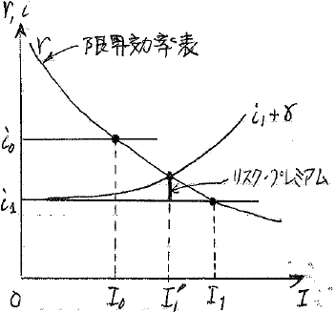
５．Marginal Efficiency of Investment in Multi-period Model
多期間モデルにおける投資の限界効率
Multiple-period model of n periods, expected profits from the next period to the nth period ahead Q₁, Q₂, ……, Q_{n} = expected gross profits= expected sales revenues-expected production costs + depreciation + borrowing interests
⇒Total sum of present value of gross expected profits discounted by a discount rate r
＝V＝Q₁／(1＋r)＋Q₂／(1＋r)²＋……＋Q _{n}／(1＋r)^{n}＝Σ_{t＝1}^{n} Q_{t}／(1＋r)^{t}
Discounted present value of expected profits
The discounted present value method
As the discount rate r, usually the market interest rate i is used
internal rate of return = which equalizes investment cost I to the discounted present value V
Keynes called it the marginal efficiency of capital
n期の多期間モデル、来期からn期先までQ₁、Q₂、……、Q_{n}の
期待収益（expected profits）＝予想販売収入から予想生産費
を引いた予想利益に、減価償却費や借入利子を加えた
粗利益（gross profits）の予想値
⇒それらを割引率rで割り引いた現在価値の総和
＝V＝Q₁／(1＋r)＋Q₂／(1＋r)²＋……＋Q _{n}／(1＋r)^{n}
＝Σ_{t＝1}^{n} Q_{t}／(1＋r)^{t}
期待収益の割引現在価値（discounted present value of
expected profits）
割引現在価値法（method of discounted present value）
割引率rには、通常は市場利子率i
割引現在価値Vに投資費用Iを等しくさせるr＝内部収益率
（internal rateof return）、ケインズはそれを資本の限界効率
（marginal efficiency of capital）

Slide 13
５B．Marginal Efficiency of Investment in Multi-period Model
多期間モデルにおける投資の限界効率
Marginal efficiency of investment ⇒ Investment costs can be covered but net profit is zero.
Marginal efficiency of capital r = market interest rate i
V＝I＝Σ_{t＝1}^{n} Q_{t}／(1＋r)^{t}
When V> I, we cover the investment cost and a positive net profit is obtained, so this investment will be executed, r＞i
When V <I, we cannot cover investment costs, so this investment will not be executed, r <i
When the expected earnings in each period are the same, and n is infinite period
Q₁＝Q₂＝……＝Q_{n}＝Q and n＝∞ , ⇒ infinite equal proportional series where the first term is
Q／(1＋r) and the common ratio is 1／(1＋r) ,
V＝I＝Q／(1＋r)／(1－1／(1＋r))＝Q／(1＋r)／r／(1＋r)＝Q／r r＝Q／I＝Q／V
Execute investment plan in order of marginal efficiency ⇒ marginal efficiency r is a decreasing function of investment amount I
Marginal efficiency drops as investment increases, r＝r（I） dr／dI＝r’(I)＜0
投資の限界効率⇒投資費用は賄えるが、純利益はゼロ。
資本の限界効率r＝市場利子率i
V＝I＝Σ_{t＝1}^{n} Q_{t}／(1＋r)^{t}
V＞Iの時には投資費用を賄った上に、プラスの純利益が得られ、投資を実行、r＞i
V＜Iの時には投資費用は賄えないので、この投資は実行されず、r＜i
各期の期待収益が同じで、nが無限期間という単純な場合
Q₁＝Q₂＝……＝Q_{n}＝Qかつn＝∞で,初項がQ／(1＋r)で公比が1／(1＋r)の無限等比級数
V＝I＝Q／(1＋r)／(1－1／(1＋r))＝Q／(1＋r)／r／(1＋r)＝Q／r r＝Q／I＝Q／V
限界効率が高い順に投資計画を実行⇒限界効率rは投資額Iの減少関数
投資額が増えるにつれて限界効率は低下, r＝r（I） dr／dI＝r’(I)＜0

Slide 14
５C．Marginal Efficiency of Investment in Multi-period Model
多期間モデルにおける投資の限界効率
Schedule of marginal efficiency of investment
Marginal efficiency of capital r = market interest rate i₀ ⇒ Optimal level of investment I₀ is decided
Investment I is a decreasing function of market interest rate i
Market interest rate i is the cost of capital due to borrowing
I＝I（i） dI／di＝I’（i）＜0
⇒ Investment function is derived from the marginal efficiency of investment
As investment I is increased, the investment amount increases and the marginal efficiency decreases, so the risk associated with investment also increases
→ add risk premium γ to market interest rate
⇒ The curve representing capital cost shifts upward as i₁＋γ
投資の限界効率表（schedule of marginal efficiency of investment ）
限界効率r＝市場利子率i₀の所に、投資の最適水準はI₀に決定
投資Iは市場利子率iの減少関数
市場利子率i は借入による資本調達のコスト
I＝I（i） dI／di＝I’（i）＜0
⇒投資の限界効率から導かれる投資関数（investment function）
投資Iを増やしていくと、投資金額は増えて限界効率は下がってくるので、投資に伴うリスク（危険）も増える⇒リスク・プレミアムγを市場利子率に付加
⇒資本コストを表す曲線はi₁＋γと上方へシフト

Slide 15
６．Tobin’s q トービンのｑ
At the optimal level of investment ⇒ V＝I or r＝i
Discounted present value V / investment cost I = 1 or marginal efficiency of investment r / market rate of interest i = 1
If there is a risk premium, i + γ is used instead of i
Tobin’s q is defined as q＝V／I or q＝r／i is a concept that extended Keynes's marginal efficiency.
If Q> 1 ⇒ discounted present value of expected return V> investment cost I,
Marginal efficiency of investment r> market interest rate i , this investment is profitable.
If Q <1 ⇒ V＜I、r＜i、 This investment will not be executed.
Assume that stock market or securities market is a complete market ⇒ Discounted present value of expected earnings V is the market value of corporate value, ie the sum of stock price and liability.
Investment cost I is the price that will reacquire the present capital in the current market, that is a market capitalization of existing capital
q＝V／I＝ Firm’s value / re-acquisition price of capital
= (Total market capitalization + Total value of Liability) / Total value of asset market capitalization
投資の最適水準では⇒V＝Iまたはr＝i
割引現在価値V/投資費用I＝1 または 投資の限界効率r/市場利子率i＝1
リスク・プレミアムがある場合は、iの代わりにi＋ γとおく
トービンのq（Tobin’s q）… q＝V／I または q＝r／i …ケインズの投資の限界効率を延長した概念。
q＞1⇒期待収益の割引現在価値V＞投資費用I、投資の限界効率r＞市場利子率i ,投資は採算があう。
q＜1⇒ V＜I、r＜i、この投資は引き合わない。
株式市場や証券市場が完全市場⇒期待収益の割引現在価値Vは、企業価値の市場評価額つまり株価と負債の合計額。
投資費用Iは、資本を現在の市場で再取得する価格、現存資本の時価総額
q＝V／I＝企業価値／資本の再取得価格＝（株式時価総額＋負債時価総額）／資産時価総額

Slide 16
７．Increase in Income and Investment: Acceleration Principle
所得の増加と投資：加速度原理
Income Y increases with economic growth in the long run, and sales and expected earnings Q also increase ⇒ Investment function is not simply a decreasing function of the market interest rate i but an increasing function of income Y.
The optimal production level to maximize profits in the long run is Y*, the corresponding amount of optimal capital is K *, the ratio of K* necessary to produce Y* is the capital coefficient v. K*＝vY* , v＞1
Firms are supposed to produce an actual level of production Y to maintain the optimal Y* which maximizes profit, and to make investment to equalize actual K to the optimal K*.
K＝vY, ΔK＝I＝vΔY, dK＝I＝vdY
Increase in production and sales ΔY induces as v times investment I（＝ΔK） as that ⇒ induced investment, this investment principle is acceleration principle, v is acceleration factor. Aftalion and J. B. Clark advocated.
長期的に経済成長とともに所得Yが増加し、売上高や期待収益Qも増加⇒投資関数は単に市場利子率iの減少関数ではなく、所得Yの増加関数
長期的に利潤を最大化する最適な生産水準＝Y*、対応する最適な資本ストック＝K*、Y*を生産するのに必要なK*の量を資本係数（capital coefficient）v, K*＝vY* , v＞1
企業は現実の生産水準Yを、利潤最大化する最適な水準Y*に維持するように生産し、現実の資本ストックKも最適な水準K*を維持するように投資を行う
K＝vY, ΔK＝I＝vΔY, dK＝I＝vdY
生産高、売上高の増分ΔYが、そのv倍の投資I（＝ΔK）を誘発⇒誘発投資（induced investment）、この投資原理を加速度原理（acceleration principle）、vを加速度係数（accelerator）。アフタリオン（A. Aftalion）やクラーク（J. B. Clark）が提唱

Slide 17
７B．Increase in Income and Investment: Acceleration Principle
所得の増加と投資：加速度原理
In the discrete type of difference equation, I_{t}＝v（Y_{t}－Y_{t－1}）,
If there is a time lag of the first period, I_{t}＝v（Y_{t－1}－Y_{t－2}）
When income increases during economic rising period (ΔY> 0), investment increases more than that, and when income decreases during economic recession (ΔY <0), investment decreases further. The acceleration principle can explain these phenomena.
In the recession period, when investment decrease is larger than capital depreciation amount δK <vΔY, capital stock is intentionally impaired by that amount, so it is difficult to explain.
The capital coefficient v varies according to the economic situation ⇒ In the acceleration principle, a fixed capital coefficient v is assumed, so it is difficult to explain it as a reality.
離散型の差分では、 I_{t}＝v（Y_{t}－Y_{t－1}）、
1期の時間の遅れ（time lag）がある場合、 I_{t}＝v（Y_{t－1}－Y_{t－2}）
景気上昇期に所得が増えると（ΔY＞0）それ以上に投資が増え、景気後退期に所得が減ると（ΔY＜0）それ以上に投資が減るという激しい投資変動を説明
景気後退期に、資本減耗分δKより投資減少分が大きい場合（δK＜vΔY）、その分だけ資本ストックを意図的に減損させるので、説明が困難
資本係数vは景気状況に応じて可変的⇒加速度原理では固定的な資本係数vを仮定しているため、現実の説明としては無理

Slide 18
８．Capital Stock and Investment: Capital Stock Adjustment Principle
資本ストックと投資：資本ストック調整原理
Capital stock adjustment principle
= K_{t}* is an optimal capital stock in the present period to maximize profit. To assume to make investment in the present period in order to fill in the difference with actual capital stock K_{t－1} at the end of the previous period. I_{t}＝K_{t}*－K_{t－1}
If the difference K_{t}*－K_{t－1} is all invested in the current period, I_{t＋1}＝K_{t＋1}*－K_{t}*
Gross investment that adds capital depreciation is, δ as depreciation rate,
I_{t}＝K_{t}*－K_{t－1}＋δK_{t－1}, I_{t＋1}＝K_{t＋1}*－K_{t}*＋δK_{t}
In the acceleration principle, I_{t}＝v（Y_{t}－Y_{t－1}） , substitute the relation of vY_{t}＝K_{t}、
vY_{t－1}＝K_{t－1} and assume that real production Y and capital stock K are instantly maintained at the optimum level, then I_{t}＝K_{t}*－K_{t－1}*
Classical capital stock adjustment principle is a deformation of the acceleration principle, and thus it suffers from the same difficulty as the acceleration principle.
資本ストック調整原理（capital stock adjustment principle）
＝利潤最大化を実現する今期の最適な資本ストックをK_{t}*とすると、前期末の実際の資本ストックK_{t－1}との差を埋めるように、今期の投資を行う場合, I_{t}＝K_{t}*－K_{t－1}
差額K_{t}*－K_{t－1}がすべて今期に投資される場合, I_{t＋1}＝K_{t＋1}*－K_{t}*
資本減耗の部分を加えた粗投資は、δを減価償却率として,
I_{t}＝K_{t}*－K_{t－1}＋δK_{t－1}, I_{t＋1}＝K_{t＋1}*－K_{t}*＋δK_{t}
加速度原理のI_{t}＝v（Y_{t}－Y_{t－1}）において、vY_{t}＝K_{t}、vY_{t－1}＝K_{t－1}、の関係を代入し、現実の生産高Yも資本ストックKも瞬時に最適水準に維持されると仮定, I_{t}＝K_{t}*－K_{t－1}*
古典的な資本ストック調整原理は、加速度原理の変形、加速度原理と同じ難点

Slide 19
８B．Capital Stock and Investment: Capital Stock Adjustment Principle
資本ストックと投資：資本ストック調整原理
Neo-classical Capital Stock Adjustment Principle=D. Jorgenson introduced time lags, setting λ as an adjustment coefficient, I_{t}＝λ（K_{t}*－K_{t－1}）, 0＜λ＜1
Gross investment with added part of capital depreciation, I_{t}＝λ（K_{t}*－K_{t－1}）＋δK_{t－1}
Jorgenson considered that an adjustment factor λ is constant and independent of the capital stock K.
But, in fact, λ is variable, and becomes low when the economy is in depression and the occupancy rate is low .
In the economic recovery period and the boom period, λ is small, when the capital stock is idle in the recession period and the occupancy rate is low.
Although the difference (K_{t}*－K_{t－1}) is negative and the investment is also negative, impairment of capital is so difficult that λ is small.
新古典派の資本ストック調整原理、ジョルゲンソン（D. Jorgenson）は、時間の遅れ（time lag）を導入、λを調整係数（adjustment coefficient）, I_{t}＝λ（K_{t}*－K_{t－1}） 0＜λ＜1
資本減耗の部分を加えた粗投資, I_{t}＝λ（K_{t}*－K_{t－1}）＋δK_{t－1}
ジョルゲンソンは調整係数λが資本ストックKとは独立に決まる定数
景気回復期、好況期になると、λは可変で、不況期で資本ストックに遊休があって稼働率が低い場合にはλは小、
差額（K_{t}*－K_{t－1}）はマイナスで投資もマイナスとなるが、資本の減損はすぐには難しいのでλは小

Slide 20
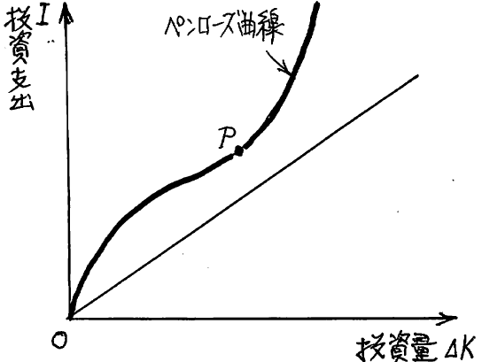
９．Investment and Adjustment Cost: Adjustment Cost Model
投資と調整費用：調整費用モデル
Acceleration principle and capital stock adjustment principle ⇒ Adjustment cost associated with an increase in investment is zero
It is additionally incurred as the amount of investment increases. For example, in the case of doubling the size of factories and machinery and equipment, expenses are more than doubled as a result of increased demand for materials related to plant construction. Parts that are more than twice as expensive as adjustment costs
If the adjustment cost is zero ⇒ The increase in the investment amount and the investment expenditure are proportional,
Adjustment cost is required ⇒ Reversed S shape cost curve is called Penrose curve.
The increasing part of the curve which is upper than the point P is called an investment effect curve.
加速度原理や資本ストック調整原理⇒投資増加に伴う調整費用はゼロ 13-9図
投資量の増大に伴って付加的に発生する費用である。
例えば工場や機械設備などを2倍に拡張する場合、工場
建設に関わる資材の需要増加で2倍以上の費用が掛かる。
費用の2倍を超える部分が調整費用
調整費用がゼロの場合⇒投資量の増大と投資支出額は
比例し、直線
調整費用が掛かる⇒逆S字型の費用曲線、ペンローズ曲線
（Penrose curve）
P点以上の逓増する部分を投資効果曲線
(investment effect curve）

Slide 21
10．Housing Investment 住宅投資
Housing investment = investment in private residential housing, about 3% of nominal GDP, about 1 / 4.5 compared with private capital investment.
Housing investment H forms the basis of the consumer's living and is mainly covered by housing loans, so sensitivity to interest rate or interest elasticity of long-term loan are quite large. H＝H（i, Y, K）
Construction cycle or Kuznets cycle
Cycles of construction investment is not limited to private housing investment, but includes buildings and factories for businesses and shops. Depreciation of buildings is quite long. Long-term cycles of 20 to 25 years.
Figure13-10. GDP Growth Rate, Residential Investment Growth Rate, Capital Investment Growth Rate (Change from the previous year)
住宅投資＝民間の居住用住宅への投資、名目
GDPの約3％、民間設備投資と比べると約4.5分の1。
住宅投資Hは消費者の生活基盤をなし、主として
住宅ローンによって賄われるので、長期貸出利子
率iに対する感応度、利子弾力性がかなり大きい。
H＝H（i, Y, K）
建設循環（construction cycle）とかクズネッツ・
サイクル（Kuznets cycle）
建設投資の循環は、民間住宅投資だけでなく
企業や商店の事業用ビルや工場を含む、建物
の減価償却がかなり長い、20～25年の長期循環
13－10図 GDP成長率、住宅投資成長率、設備
投資成長率（前年同期比変化率）

Slide 22
11．Inventory Investment 在庫投資
The final product produced by a firm and is not sold is ⇒ inventory, product inventory = production volume - sales volume
Raw material inventory = raw materials purchased as them but still not input into production process
Semi-finished goods inventory = semi-finished goods which are owned in the middle of the production process and not finished product
Shares of raw material inventory, raw material inventory and product inventory= 25%, 45%, 30%
Inventory is not consumption, but for national accounts, investment, inventory investment
企業が生産した最終生産物は、販売されなければ⇒在庫（inventory）, 製品在庫（product inventory）ともいう. 製品在庫＝生産量－販売量
原材料在庫（raw material inventory）＝原材料として購入されたが、まだ生産過程に投入されないで保有
仕掛品在庫（semi-finished goods inventory）＝生産過程の途中にあって完成品になっていないままの状態で保有
原材料在庫、仕掛品在庫、製品在庫の在庫に占める割合＝25％、45％、30％
在庫は消費ではなく、国民経済計算上は投資、在庫投資（inventory investment）

Slide 23
11B．Inventory Investment 在庫投資
The share of inventory among GDP is very small, 0.7% on average for Japan in 2009 to 2011.
Inventory investment is accumulated when unsold goods are accumulated, and is withdrawn when product shortage occurs.
Responsively to supply / demand gap = excess demand (D－Y), V＝V（D－Y）
Role of inventory is to adjust to a gap of demand and supply and to business cycle as a shock absorber or buffering goods. ⇒ The fluctuation range is larger than private capital investment and housing investment, reflecting sensitively cyclical fluctuations of supply and demand gap. inventory cycle, Kitchin cycle
GDPに占める割合は非常に小さく、日本の2009～2011年の平均では0.7％
在庫投資は、売れ残りが出ると積み増され、品不足になると取り崩される。
需給ギャップ＝超過需要（D－Y）に敏感に反応, V＝V（D－Y）
超過需要のショック・アブソーバー（shock absorber:緩衝財）として需給調整や景気調整の役割⇒民間設備投資や住宅投資よりも変動幅が大きく、需給ギャップの循環変動を反映、在庫循環（inventory cycle）、キチン・サイクル（Kitchin cycle）

